Slide 1
Online Food Ordering System – Team 2
Members:
1. Dipesh Singh Chadgal
2. Grishma Gedela
3. Vishnu Arjun Devhare
4. Lahari Gamidi

Slide 2
Team Members Contributions
Each team member played an integral role in the successful development and completion of this project.
Teamwork made this project possible.
Each Member have worked on each part of the project.

Slide 3
Abstract
Digital platform streamlining food ordering and delivery
Components: Users, Restaurants, Menus and Orders

Slide 4
File System of Django
Template Folder: Contains HTML templates.
Static Folder: Holds CSS, JavaScript, and image files.
model.py: Defines database models.
views.py: Contains HTTP request handling logic.
urls.py: Specifies URL patterns.

Slide 5
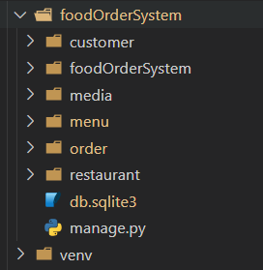
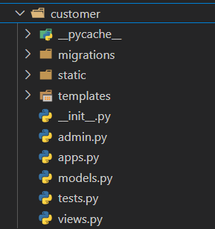
Apps
Files and Folder inside Apps

Slide 6
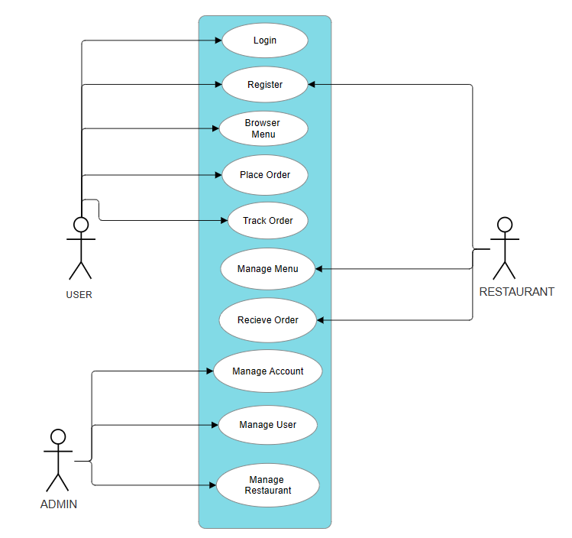
Use Case Diagram

Slide 7
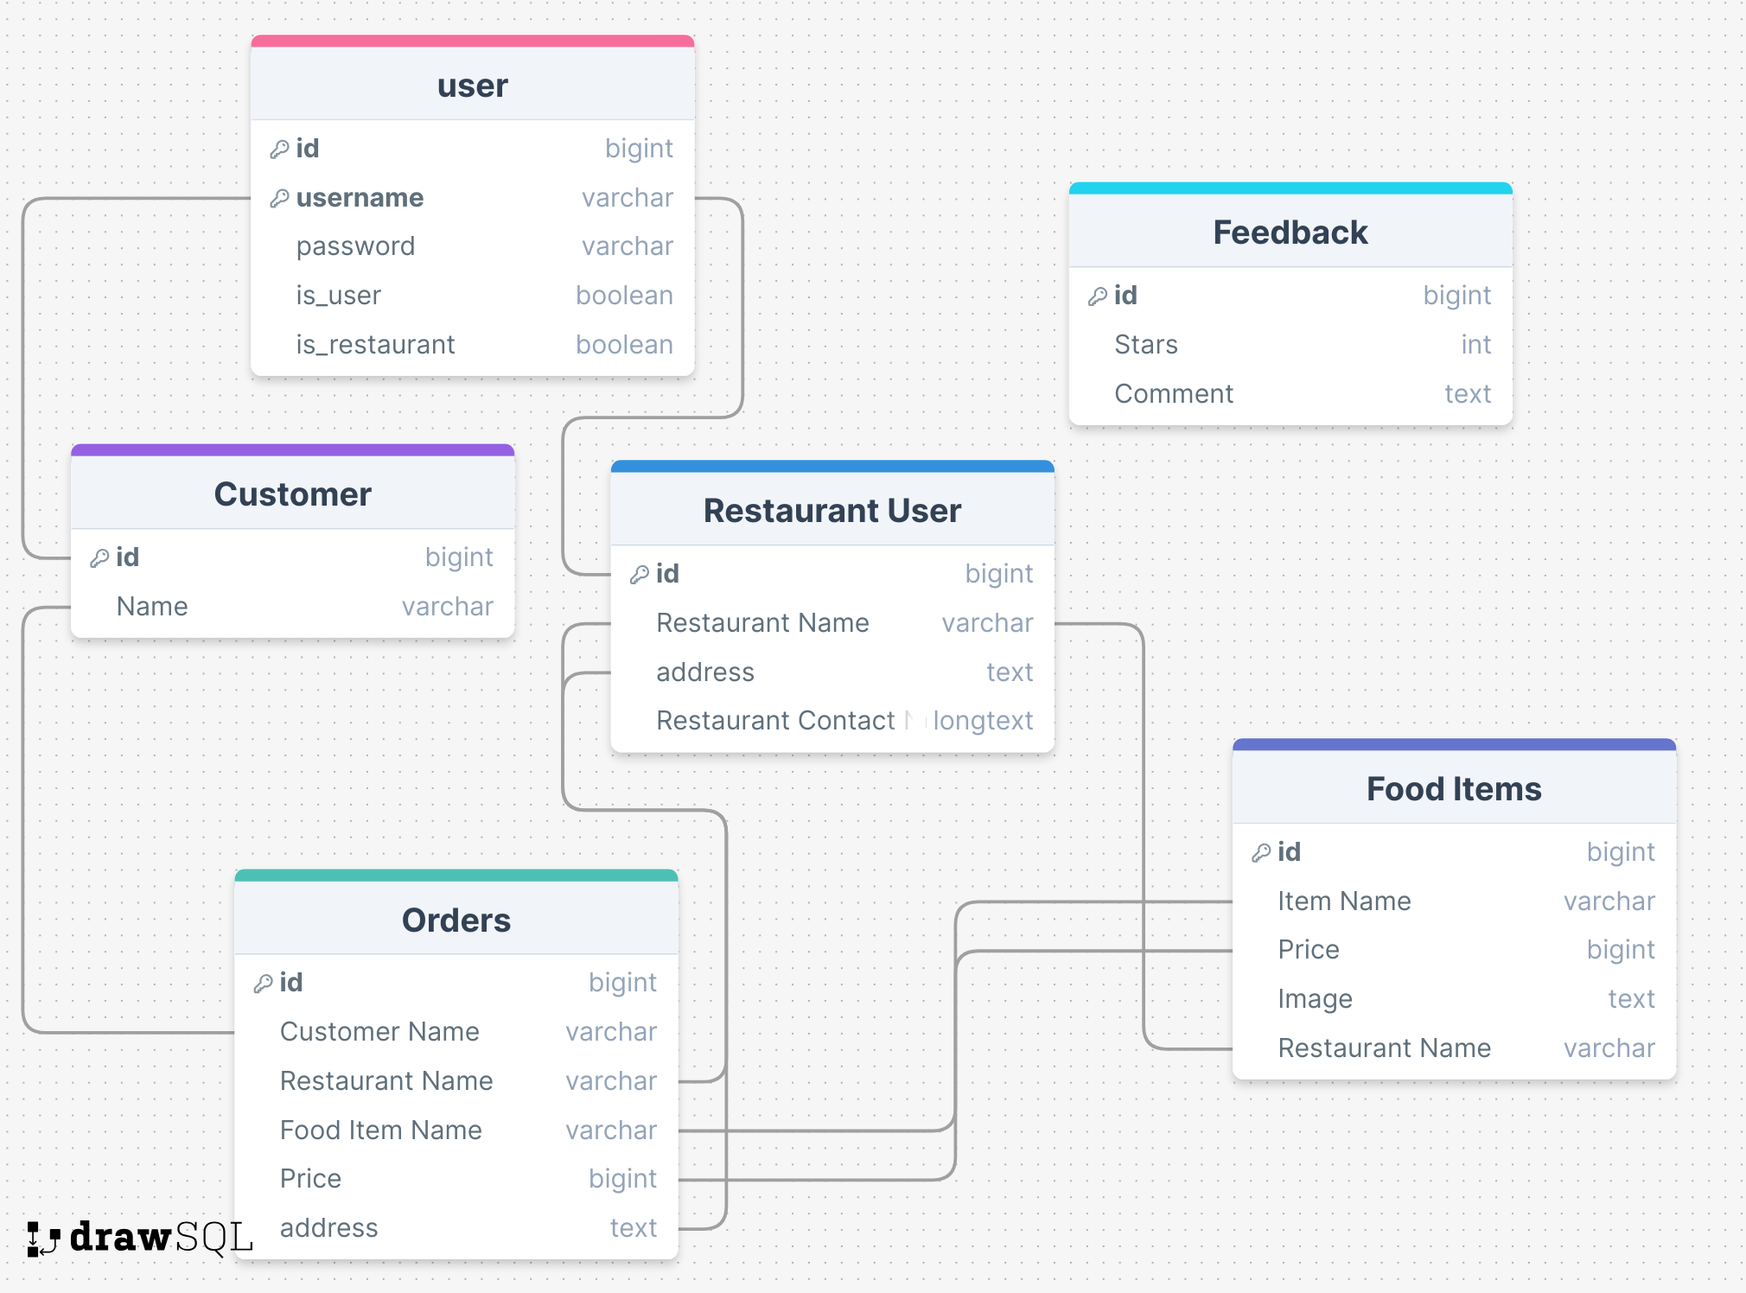
Database Schema

Slide 8
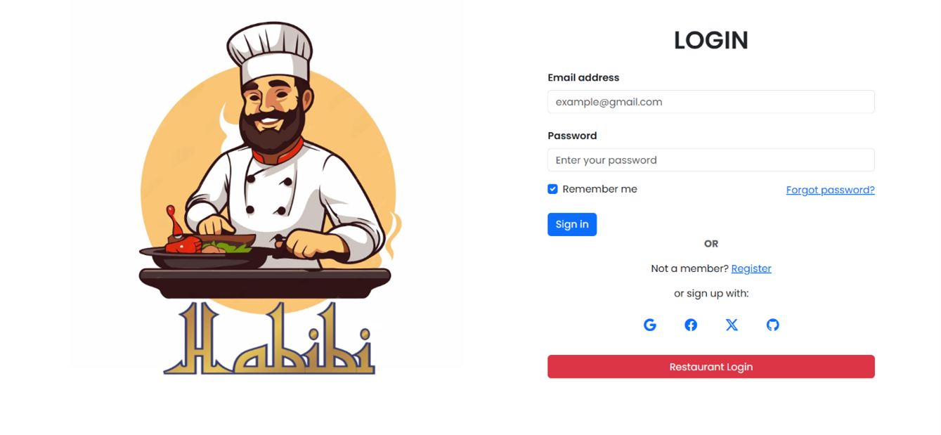
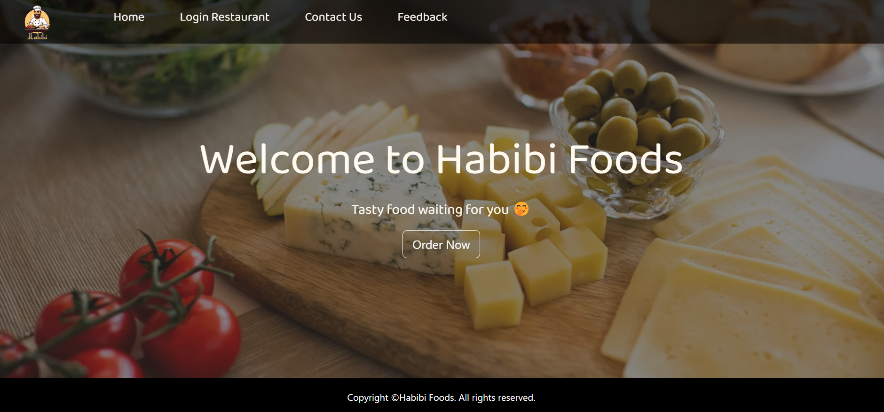
Project Visuals

Slide 9
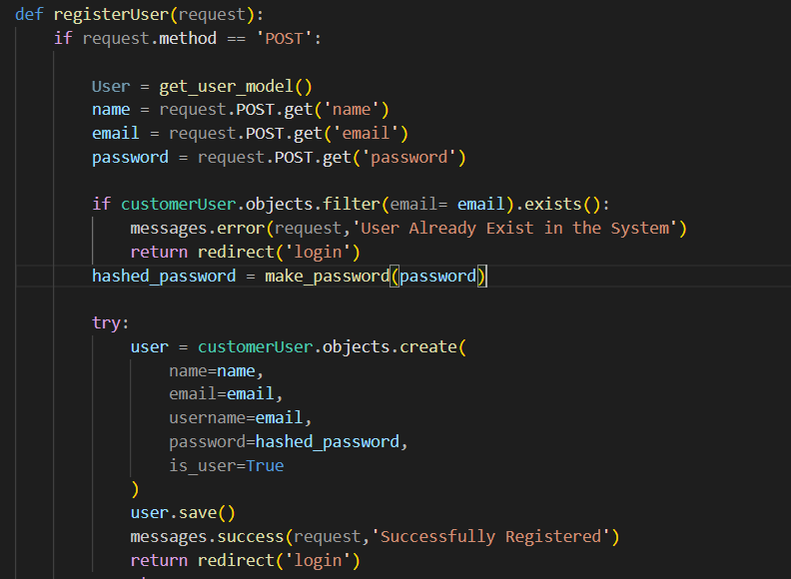
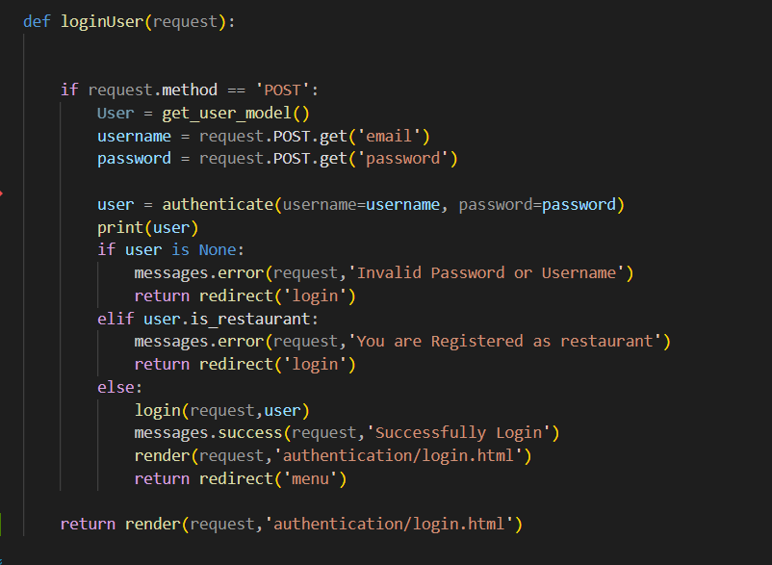
USER MODEL

Slide 10
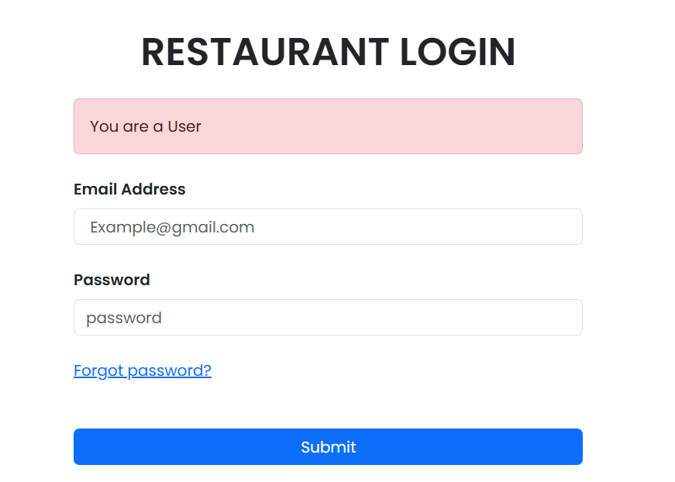
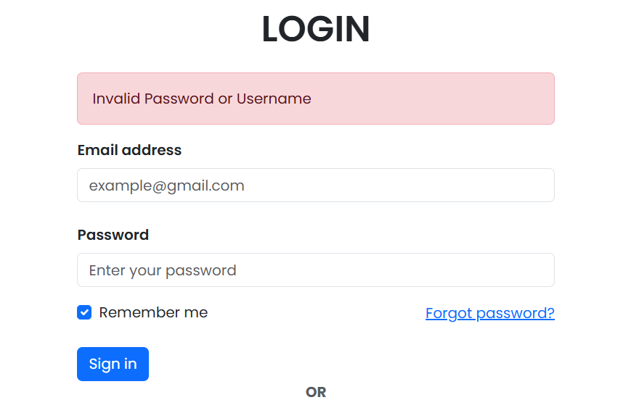
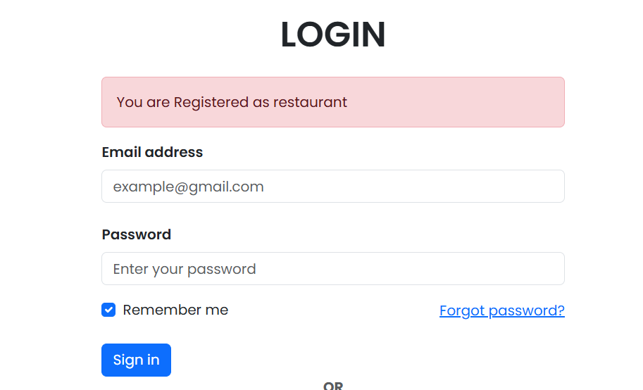
Errors !!! Errors !!! No Worries… we caught them for you 🤭

Slide 11
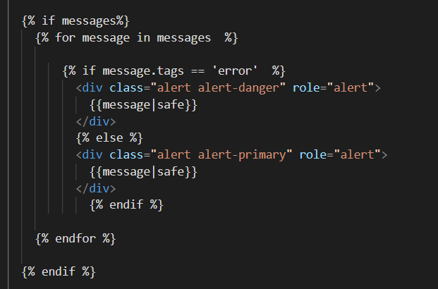

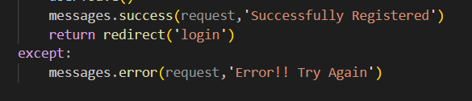
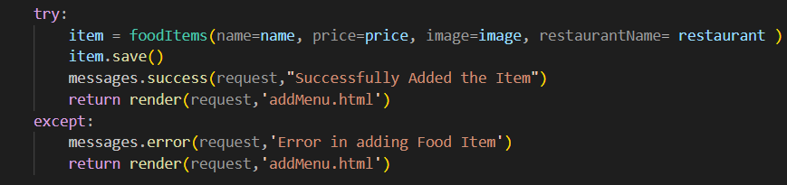
ERROR HANDLING / CASE HANDLING

Slide 12
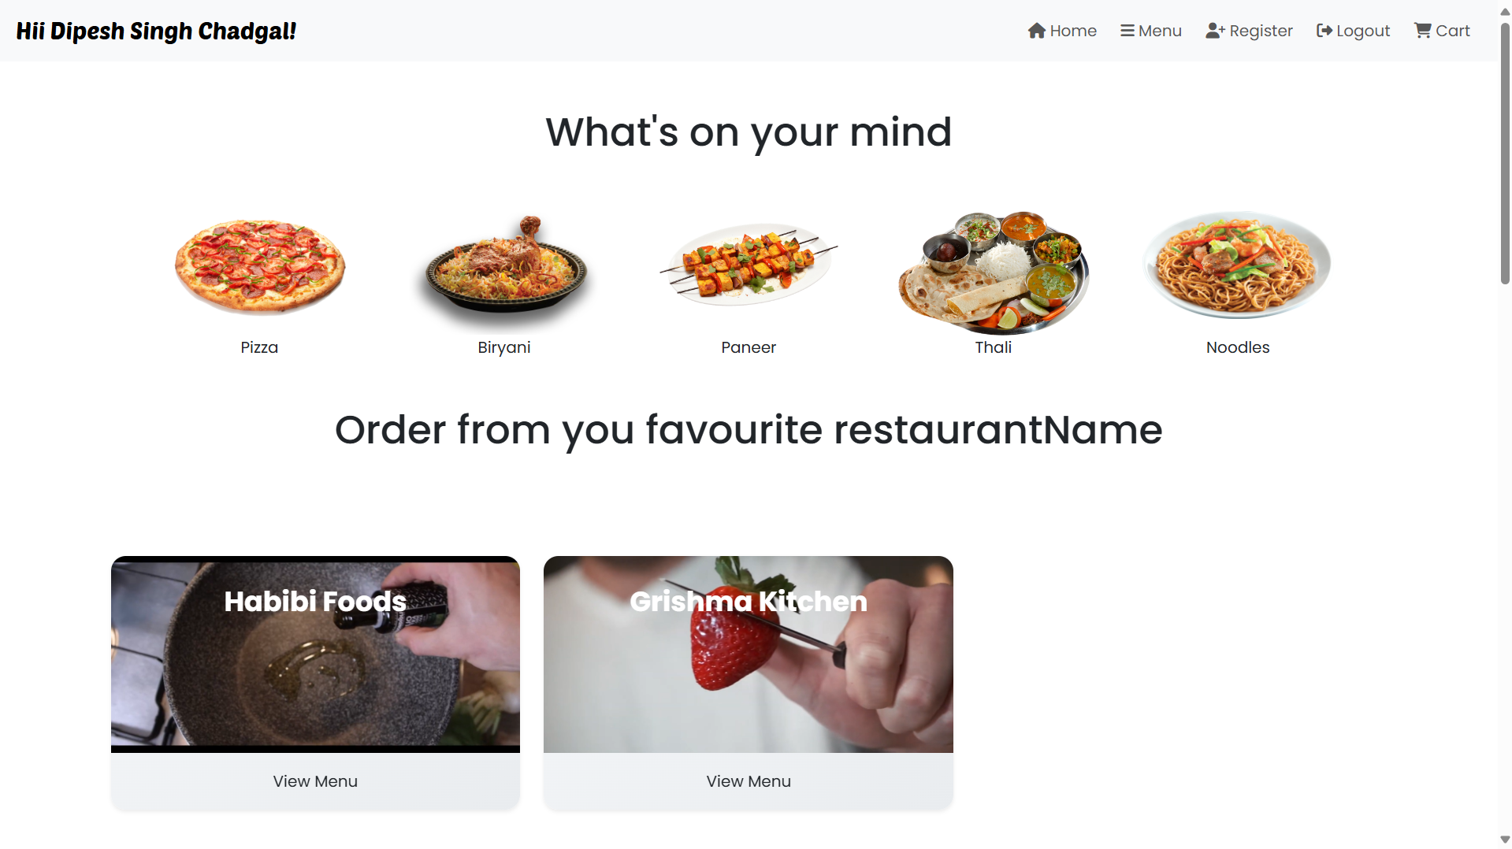
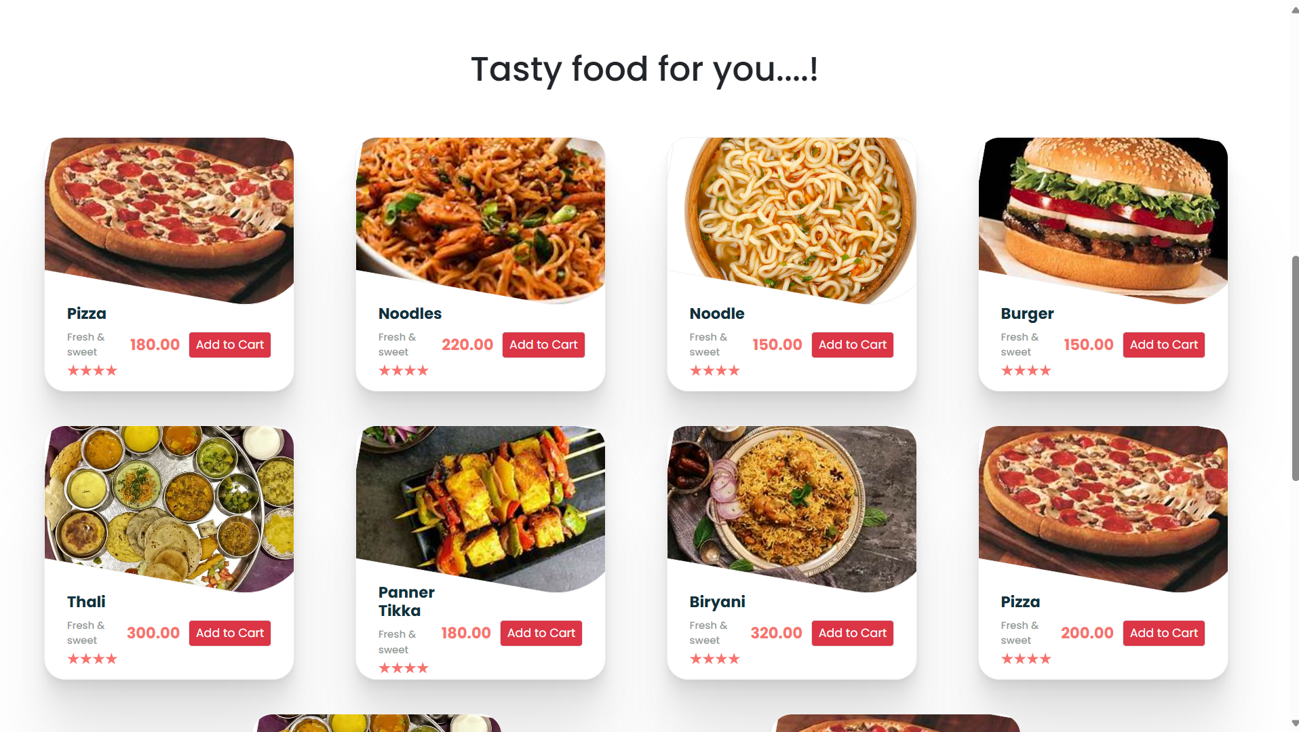
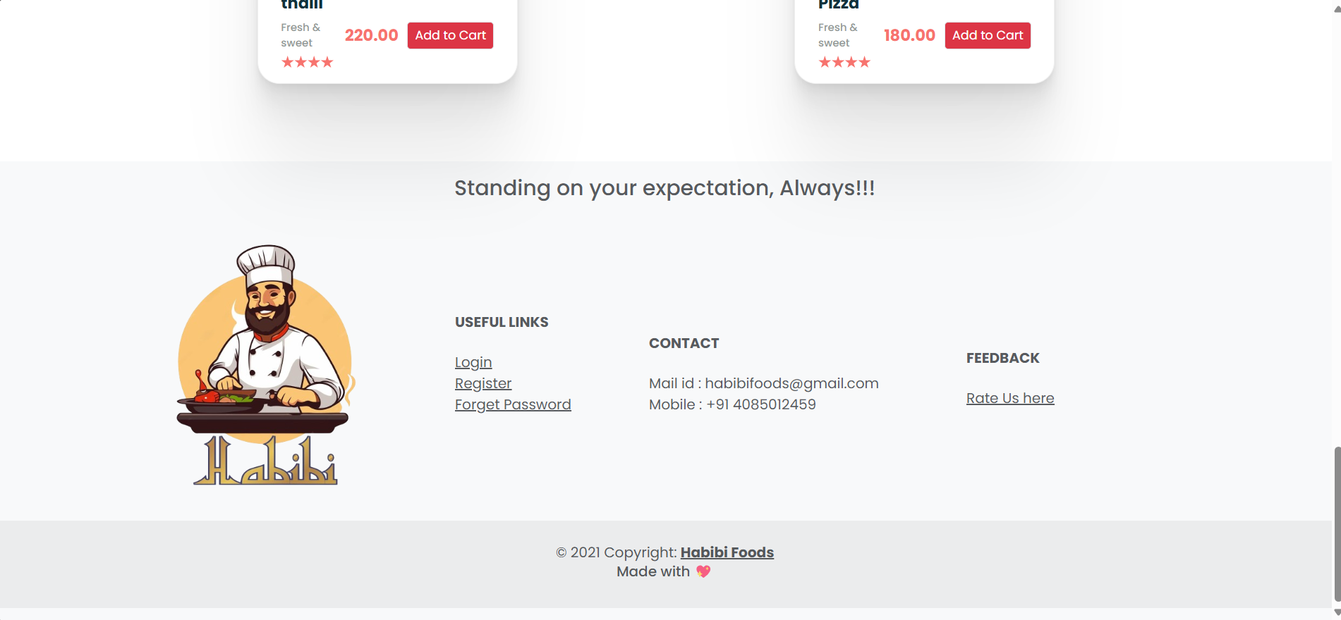
Menu Page

Slide 13
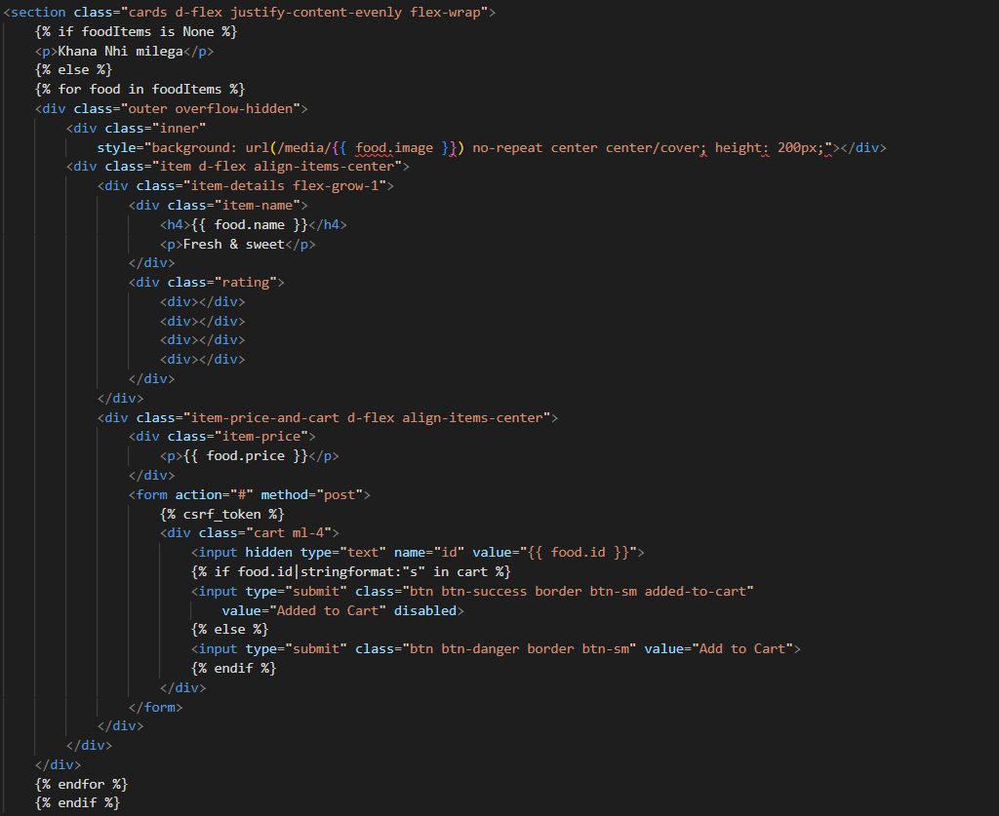
Food Item Card Display

Slide 14
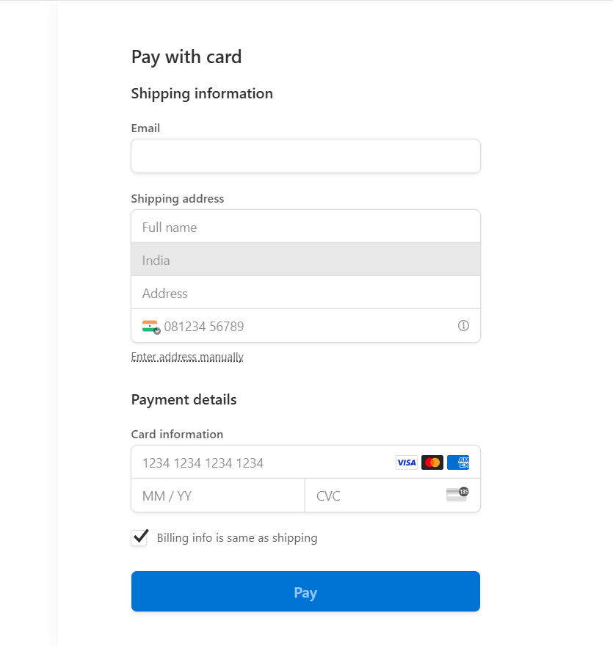
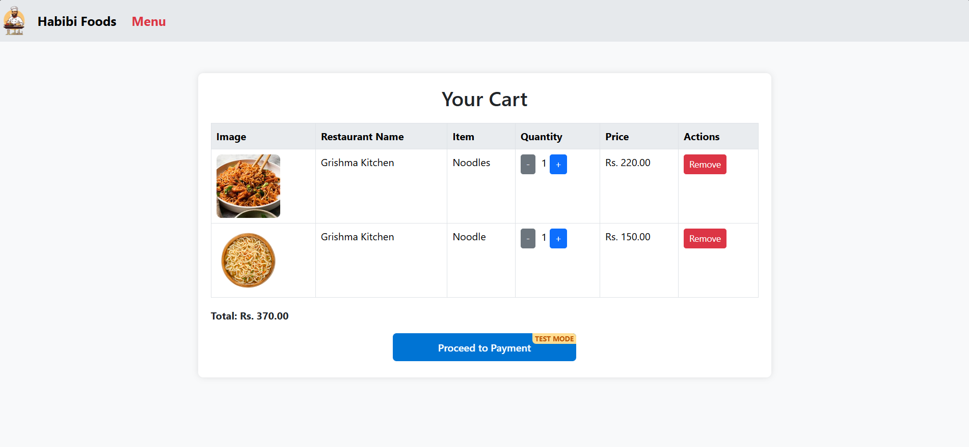
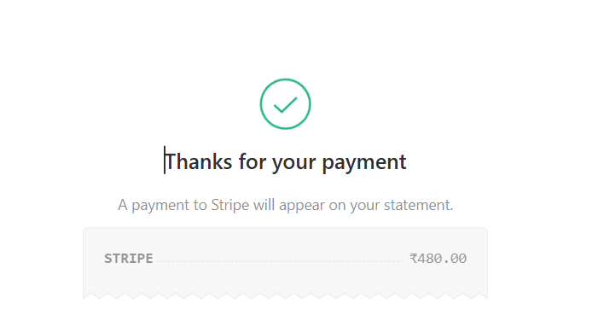
Cart and Payment Pages

Slide 15
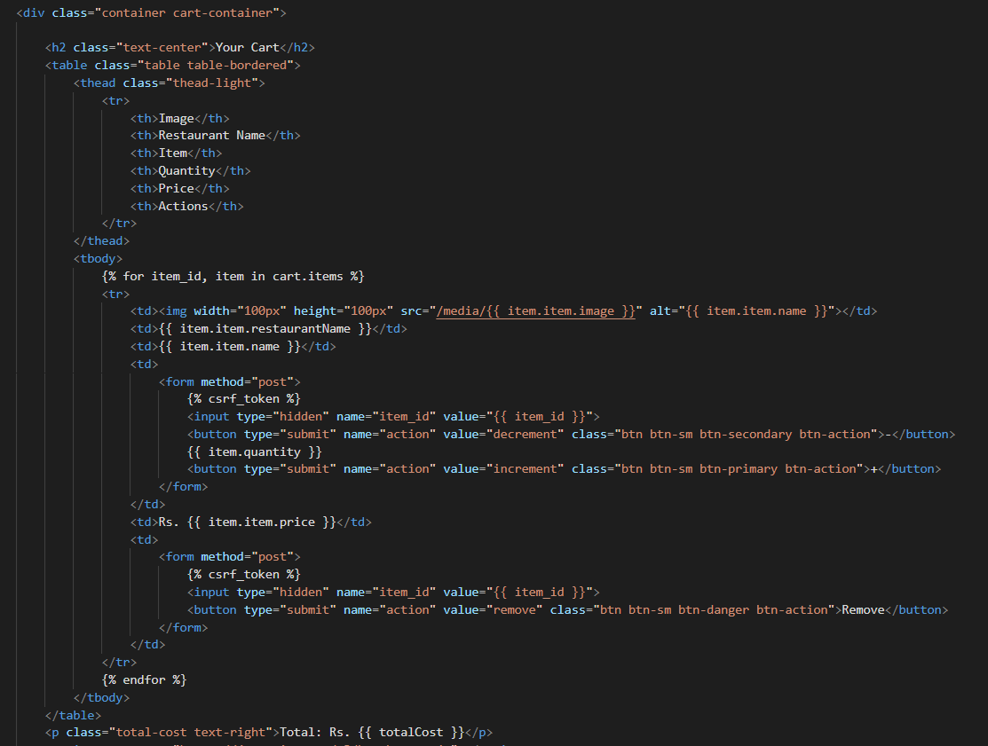
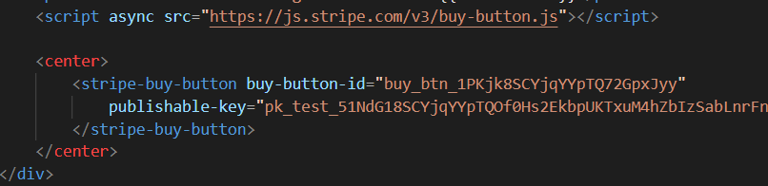
Payment and Cart
Payment using stripe
Cart Implementation

Slide 16
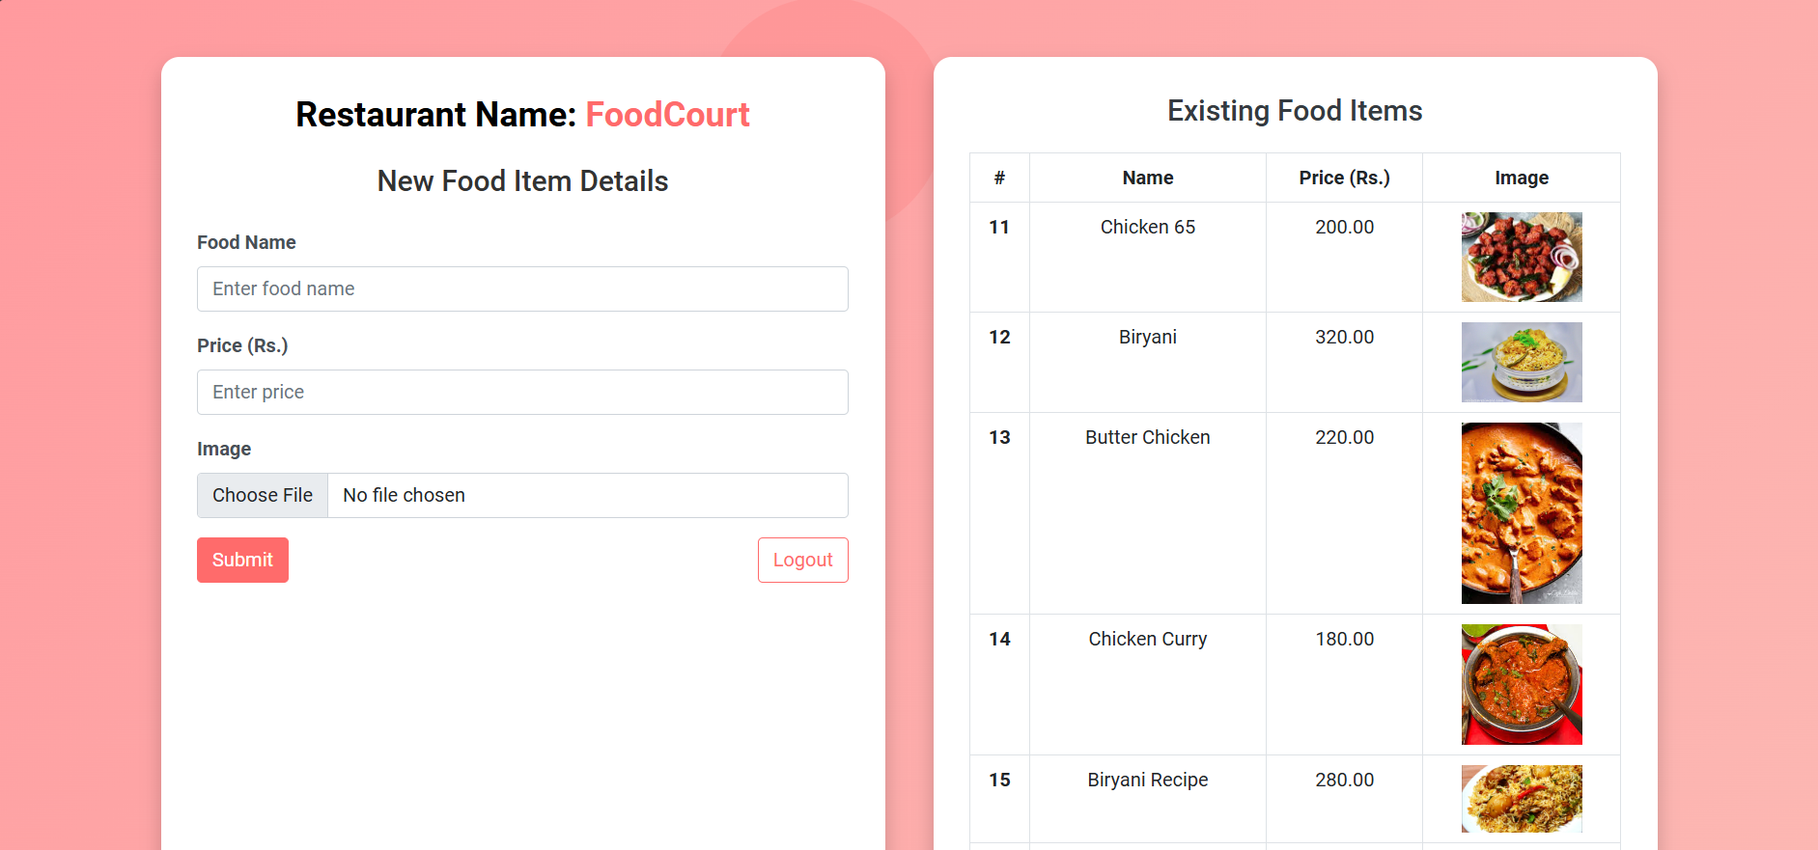
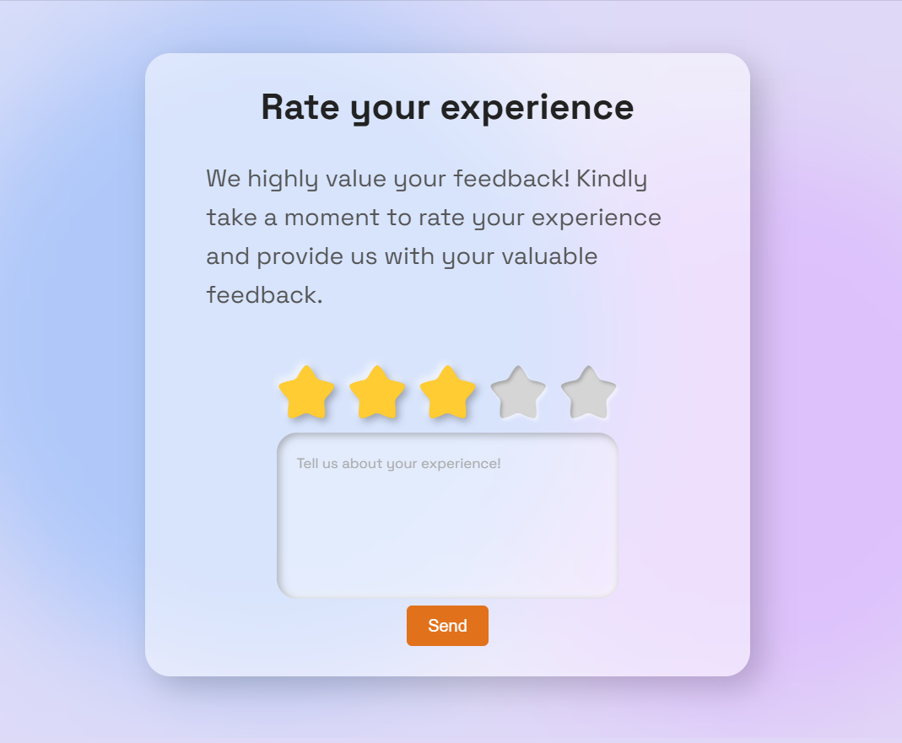
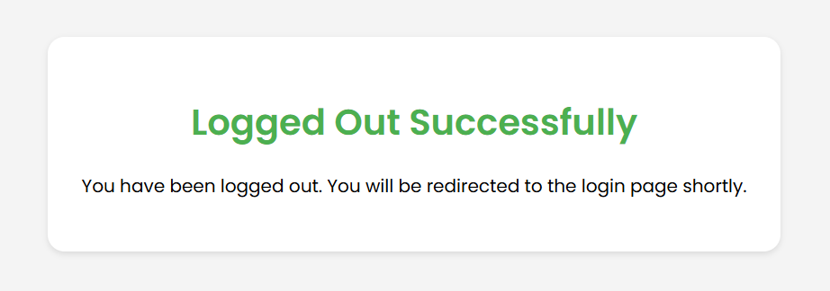
Feedback Matters

Slide 17
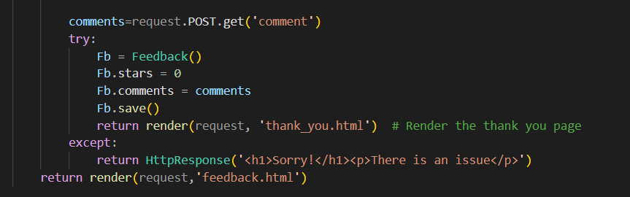
Feedback

Slide 18

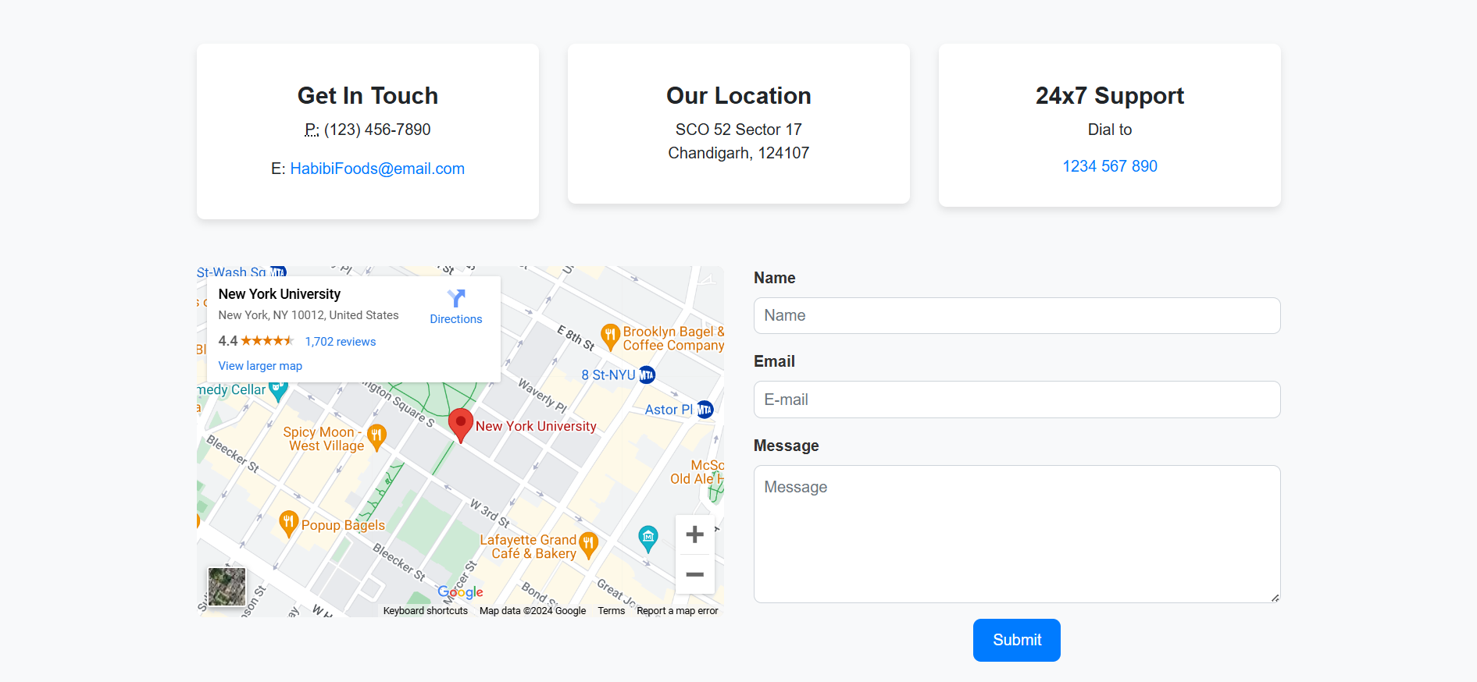
Contact us and Forget password page

Slide 19
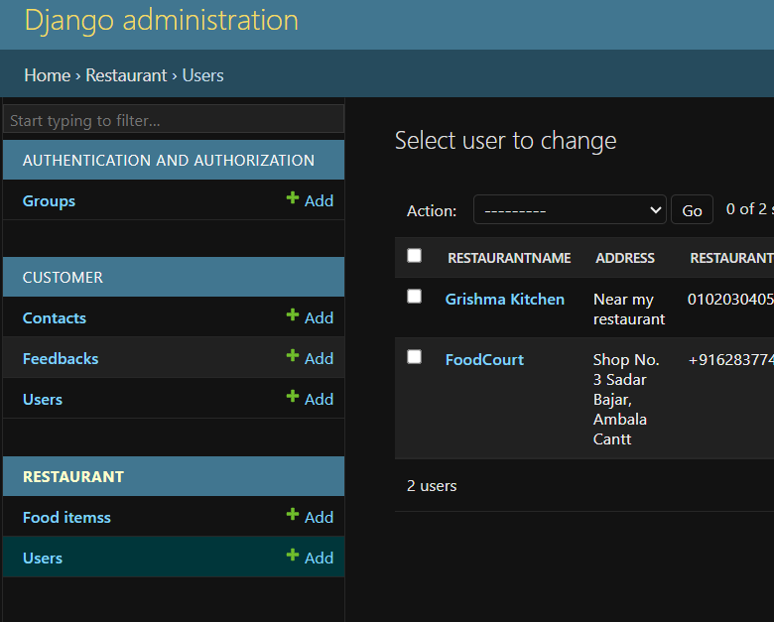
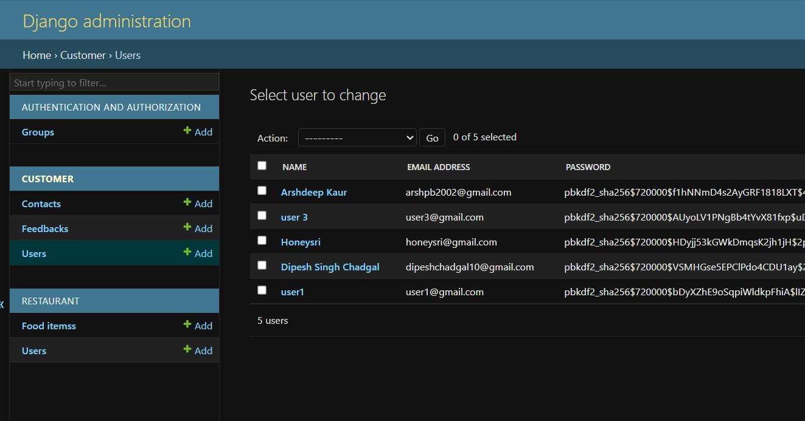
Admin Panel

Slide 20
Future Scope
Advanced Filters
Real-time Order Tracking
Dashboard for Restaurants
Customer Insights
Multi-Language Support:

Slide 21
Thank you

